Slide 1
Clustering
Organizing data into groups such that there is
high intra-cluster similarity
low inter-cluster similarity
Also called unsupervised learning, sometimes called sorting by psychologists and segmentation by people in marketing
Clustering Approaches
Partitional
Hierarchical

Slide 2
Partitional Clustering
Gives non-overlapping clusters
Normally inputs the desired number of clusters
D1 D2 D3 D4 D5
D1
D2
D3
D4
D5
0
8
8
7
7
0
2
4
4
0
3
3
0
1
D1
D2, D3
D4, D5
0

Slide 3
Top Down (Divisive) Bottom Up (Agglomerative)
Clustering Clustering
D1 D2 D3 D4 D5
D1 D2 D3 D4 D5
D1
D2
D3
D4
D5
0
8
8
7
7
0
2
4
4
0
3
3
D1 D2 D3 D4 D5
D1 D2 D3 D4 D5
0
1
D1 D2 D3 D4 D5
0
D1 D2 D3 D4 D5

Slide 4
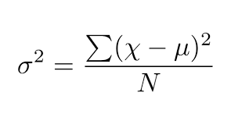
Object to cluster distance Or
Cluster to cluster distance
Single linkage (nearest neighbor): Distance between closest documents of different clusters
Complete linkage (furthest neighbor): Distance between farthest documents of different clusters
Group average linkage: Average distance of all document pairs from different clusters
Wards Linkage: Documents from different clusters with minimum variance

Slide 5
Hierarchical Clustering
D1 D2 D3 D4 D5
D1
D2
D3
D4
D5
0
8
8
7
7
0
2
4
4
0
3
3
0
1
D1 D2 D3 D4 D5
0

